Slide 1
Welcome!
PSYC121: Statistics for Psychologists 1
Week 1: Say “hello” to the Levy Lab

Slide 2
Important: attendance records
The University requires students to check in to every in-person teaching session
Each student is responsible for “checking in” themselves
Please use iLancaster app (phone or web version)
Students should look for confirmation that their check-in has been successful - check-in doesn't happen automatically.
Can’t check in?
Manual sign in sheets (but not every week)

Slide 3
Welcome to the analysis labs
Congratulations on choosing Lancaster & Psychology for your University career!
What are we – the department – trying to achieve?
You are training in a research active psychology department
We will teach you the knowledge and skills to complete data analysis
Consolidating analysis ideas
Extending particular insights
Practicing what you learn
The opportunity for you to ask, to check, to clarify etc.
Analysis as critical thinking

Slide 4
What is data analysis?
Psychology is the study of brain and behaviour
We understand both of these things by taking measurements
For example: blood oxygenation in the brain; EEG signals; decision choice; response time; preference rating
Psychology is largely a quantitative (numerical) data science
So in order to understand brain and behaviour, we need to understand how to analyse data and gain a toolbox of skills in data science.

Slide 5
Your approach to analysis
Basics:
Watch the lecture
Review the Lab work before each session: https://lu-psy-r.github.io/statistics_for_psychologists/
Go through the learnr tutorial beforehand for each week
Charge and bring your laptop (PC, Mac, Chromebook – or loan one...)
Your mindset:
Room is booked for 2 hours, but staff are timetabled for the first 90 minutes
“This week the task was a cinch, and I’ve finished” (Great!)
"This week it's taking me longer" (that's fine!)
Data skills takes time
– you need to schedule to do more than these workshops and the lectures
With practice and effort, every student can gain the skills needed.
You will create your own data to illustrate analysis principles

Slide 6
Advice from Lancaster students who have been here before
“Being good at R isn’t about being able to write lines of perfect code it’s about problem solving and [Stackoverflow]… mostly Stackoverflow.
It is very difficult at first and the simplest lines of code won’t run etc. but you do finally learn how to negotiate with it (that doesn’t always mean that it listens)
…but eventually during my second year it started to click and at that point R becomes quite addictive and you are doing it for fun”

Slide 7
Advice from Lancaster students who have been here before
“I found it really helpful at the beginning of my learning process to write notes besides each line of code to explain exactly what the code means and what the function does, down to every symbol. Essentially translating pieces of code in my own words. And after a while, you’ll get more used to the R language. ”
“Having dyscalculia at school, I was always good at understanding the logic of maths but would get it all wrong once the numbers got involved. But because R is written language it meant I could be really good at maths because I wasn’t held back by the dyscalculia anymore which is really cool.”

Slide 8
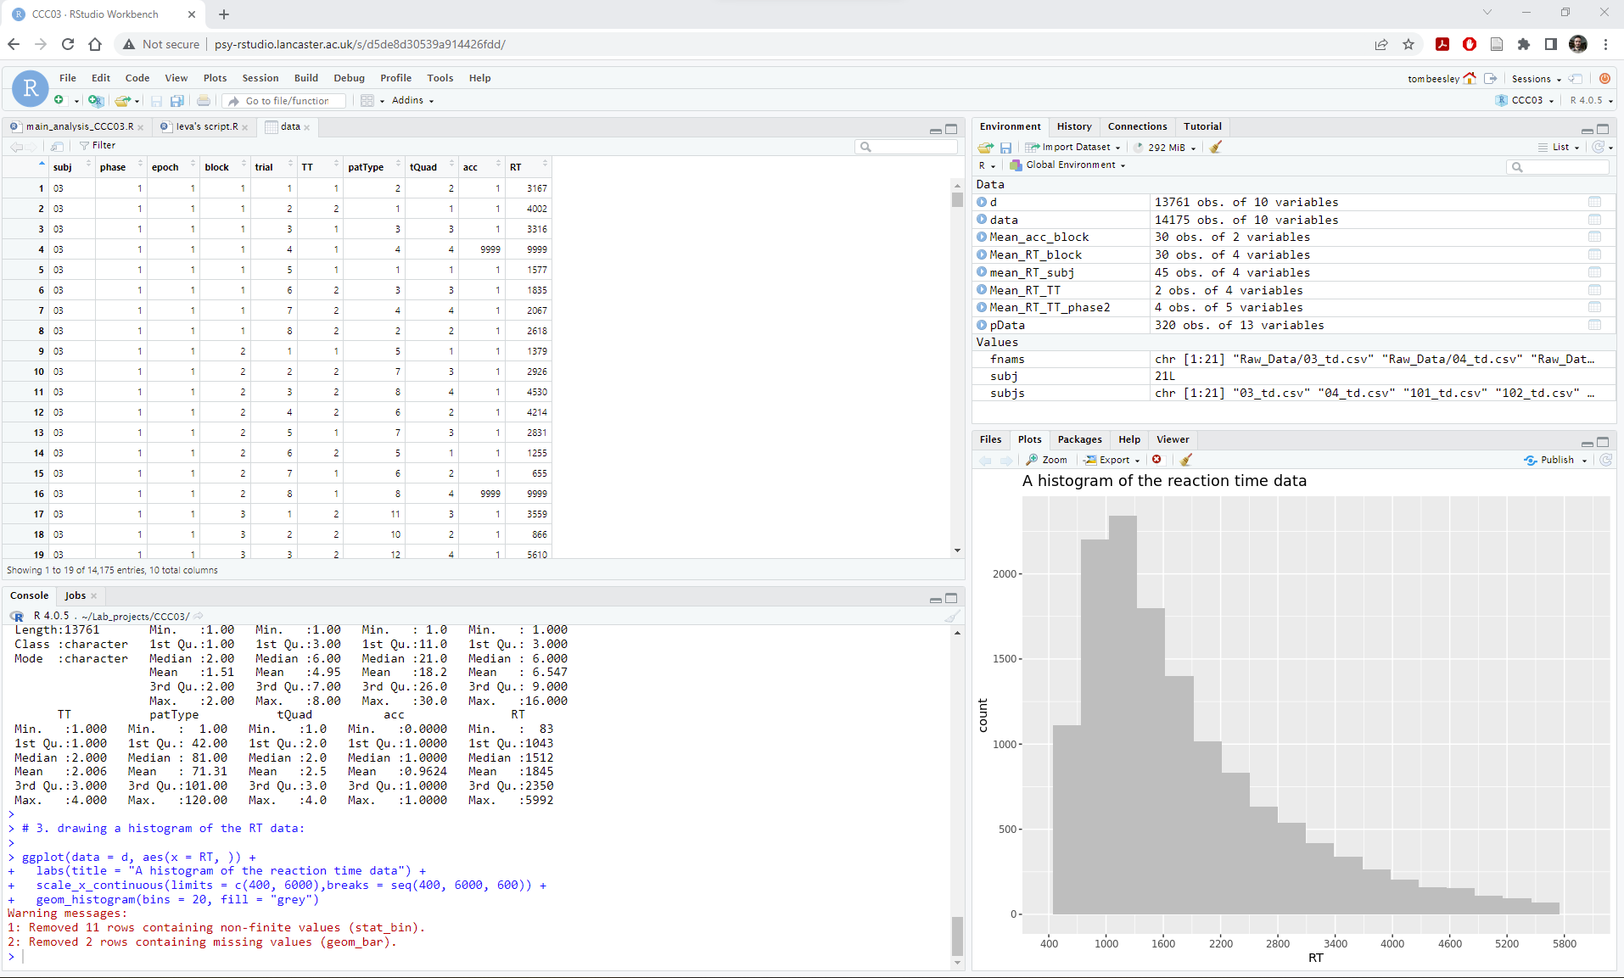
What is R?

Slide 9
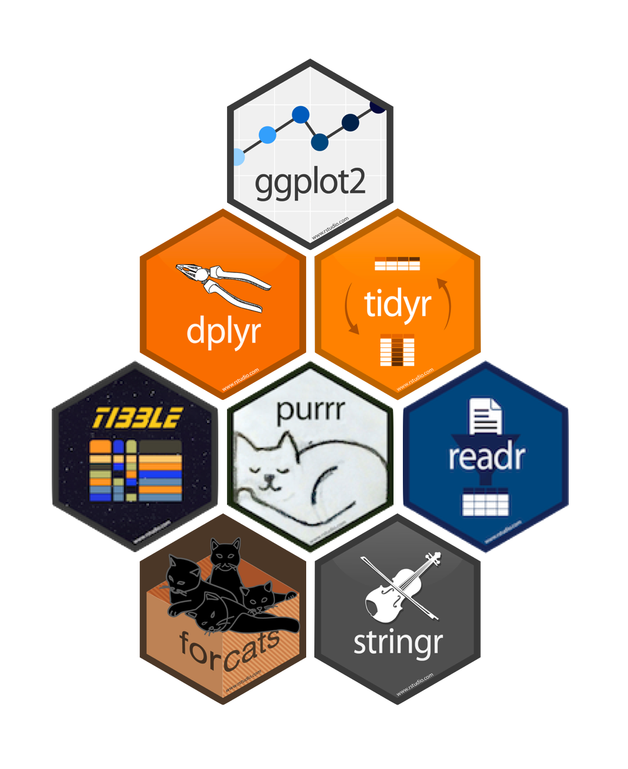
You will learn the “tidyverse”
Widely used set of “packages” for R data analysis
Uses a consistent set of “verbs” and syntax for working with data
For example:
my_data %>%
filter(RT < 5000)
my_data %>%
select(p_num, block, RT, accuracy)

Slide 10
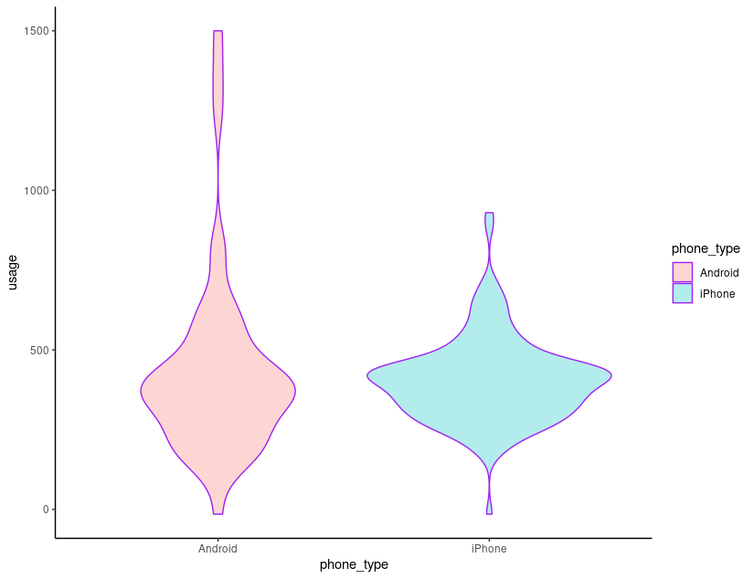
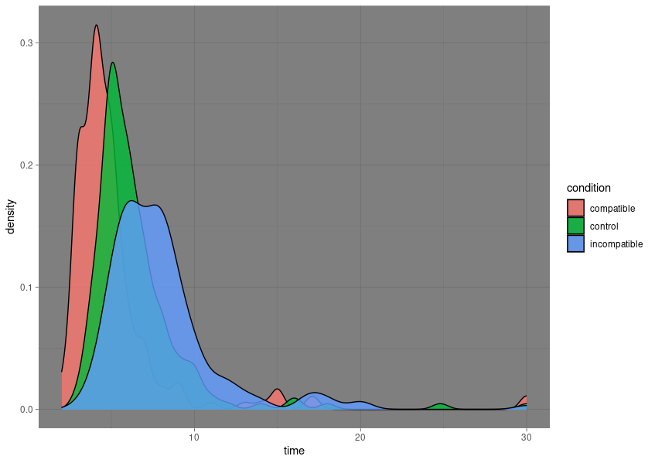
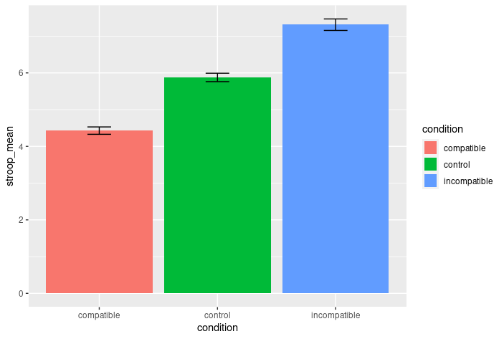
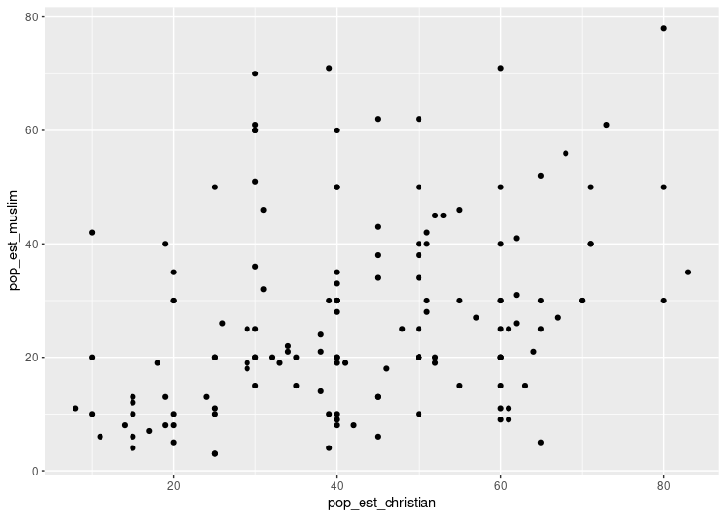
Example work in PSYC121

Slide 11
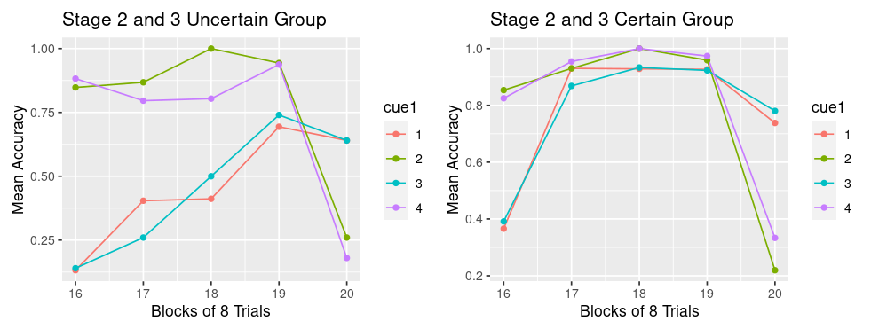
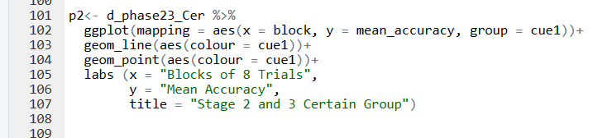
Y3 Dissertation students

Slide 12
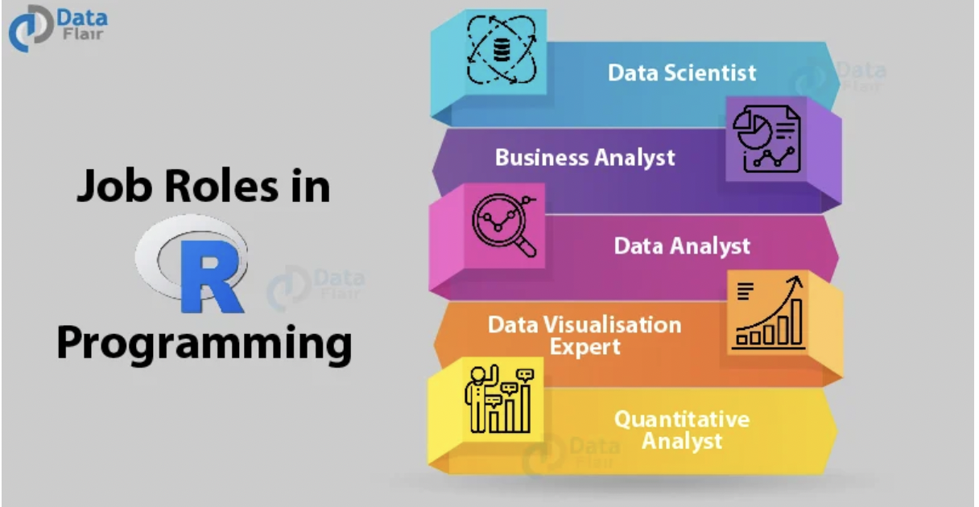
Beyond university?

Slide 13
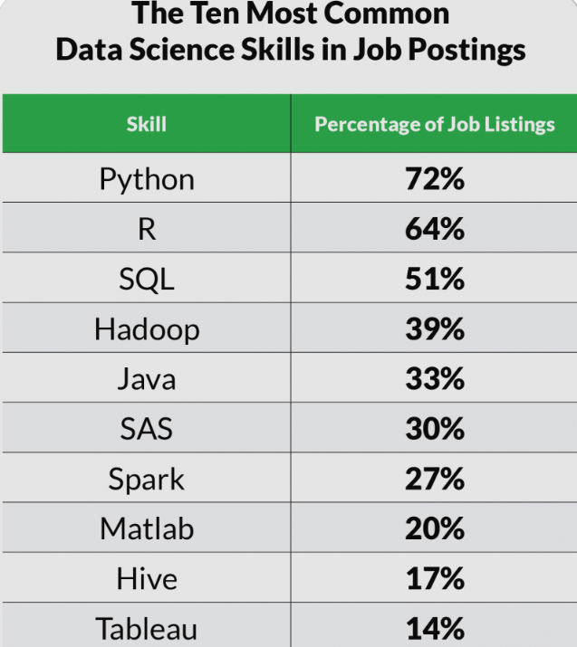
Is R the future?
Will R outlast your University experience?
R has a vast online support community

Slide 14
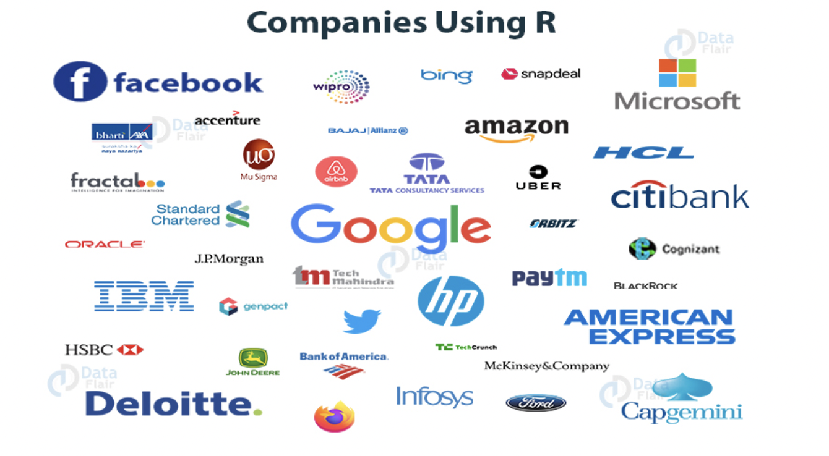

Slide 15
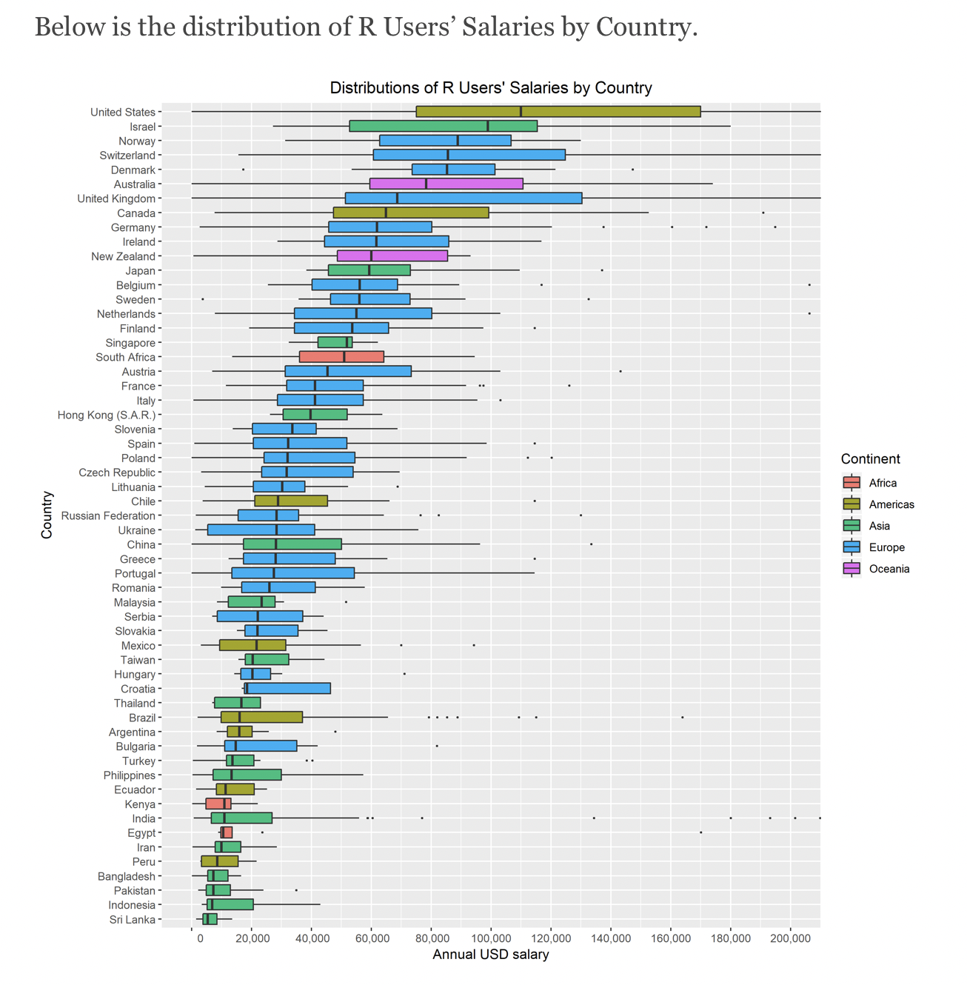

Slide 16
Analysis in term 1
Week Topic
Intro and orientation
Central tendency and variability
Variability and z-scores
Z-scores, sampling and principles of hypothesis testing
Class test
The sampling process and probability
Binomial distributions and the sign-test
Comparing means – intro to t
Different types of t-test
Class test
Notes:
Analysis and skills labs given here – not approaches. Note approaches labs are the ones they have 4-6pm.
‘Ateam’ refers to the analysis team – i.e., you. Feel free to change this to your actual name if you prefer

Slide 17
Housekeeping
Please use Moodle for peer-peer discussion and student queries to staff
And please use Moodle effectively!
Teams and email for personal messages only please
Please respect (for To: and From: messages) the Department 7-7 policy
Weekly Q&A session on a Friday
Please set the agenda!

Slide 18
This week
Intro to the learning environment: Levy lab etc
Trying out descriptive statistics and meeting your peers
Intro to the R Studio server
Analysis involves data – so we’re acquiring useful data this week

Slide 19


